Slide 1
Apple Vision Pro Project
Donovan Kohler, Trang Do, Anthony Rutherford, Sam Kwon, Raudel Armenta

Slide 2
General Motivation
For use in university research
Allow for communication between devices
Facilitate usage of Apple Vision Pro to collect and process data
Ability to explore human robot collaboration
Connect other robots to Apple Vision Pro
Notes:
Send information between Apple Vision Pro and server for information processing or use of AI models
Distributed intelligence
Client-server architecture

Slide 3
General Motivation
Targeted User: Research participants
Student
Faculty
Robotics engineers, Robotics technicians
Notes:
Send information between Apple Vision Pro and server for information processing or use of AI models
Distributed intelligence
Client-server architecture

Slide 4
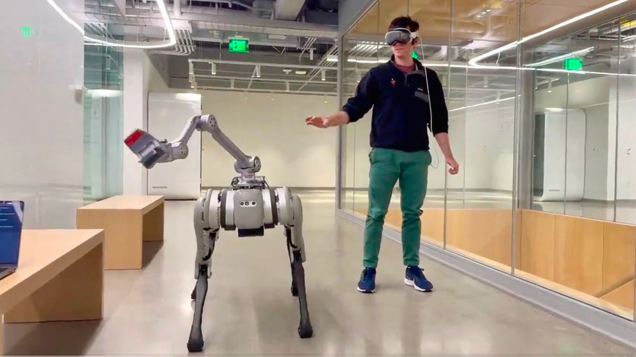
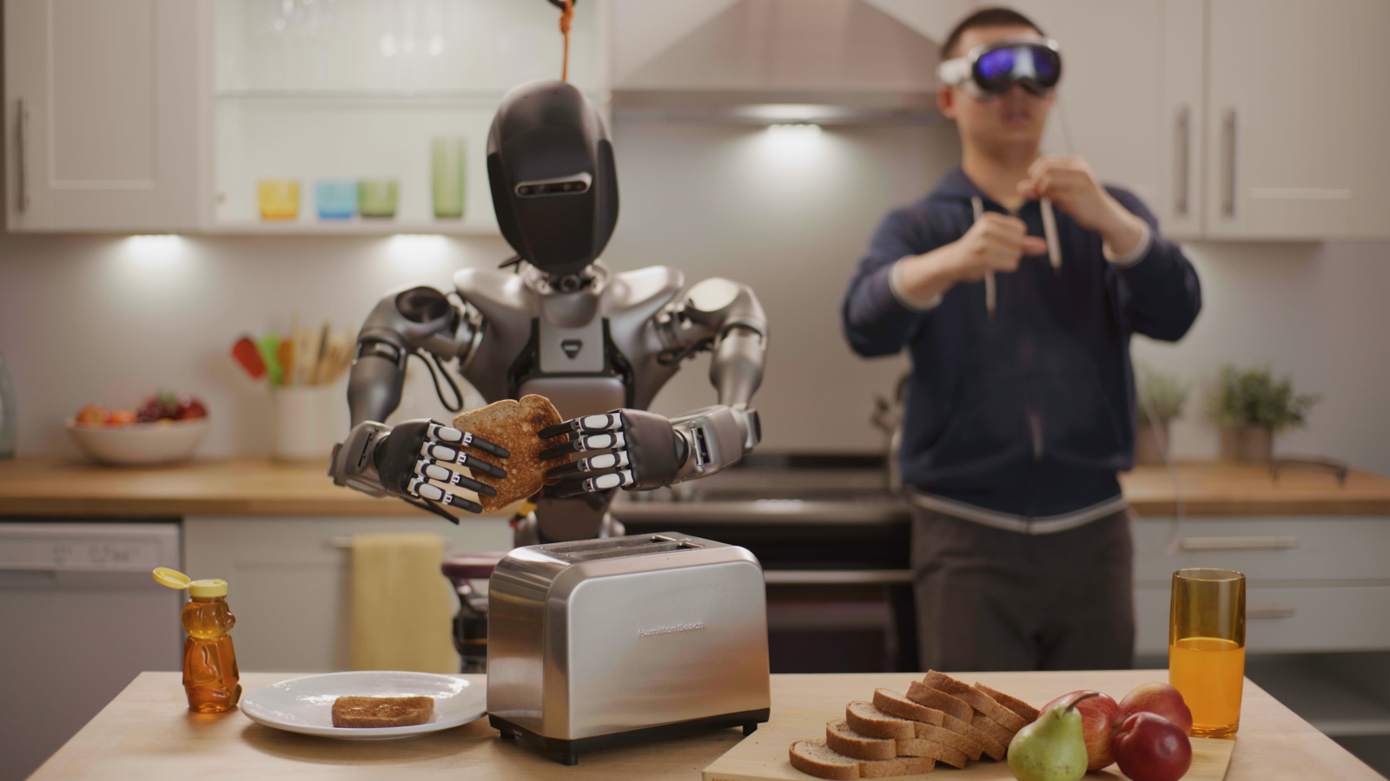
Notes:
Send information between Apple Vision Pro and server for information processing or use of AI models
Distributed intelligence
Client-server architecture

Slide 5

Core Features
Distributed intelligence (client – server architecture)
Send data between headset and server
Server-side processing components
Use ML models
Image recognition
3D space
Notes:
Send information between Apple Vision Pro and server for information processing or use of AI models
Distributed intelligence
Client-server architecture

Slide 6
Technical Details
Possible Tech
Apple Vision Pro
MacBook
VS Code
Possible APIs
Core ML --> ML Preprocessing
ARKit --> RESTful APIs
CryptoKit --> Data encryption
Gzip --> Data compression
RealityKit --> Visual rendering

Slide 7
Development Environment
Server-side:
VS Code
Python / Jupyter Notebooks
Hugging Face Models
AWS Cloud9
For working directly in cloud environment
Apple Vision Pro:
Xcode
VisionOS SDK
Vision Pro Simulator for testing

Slide 8
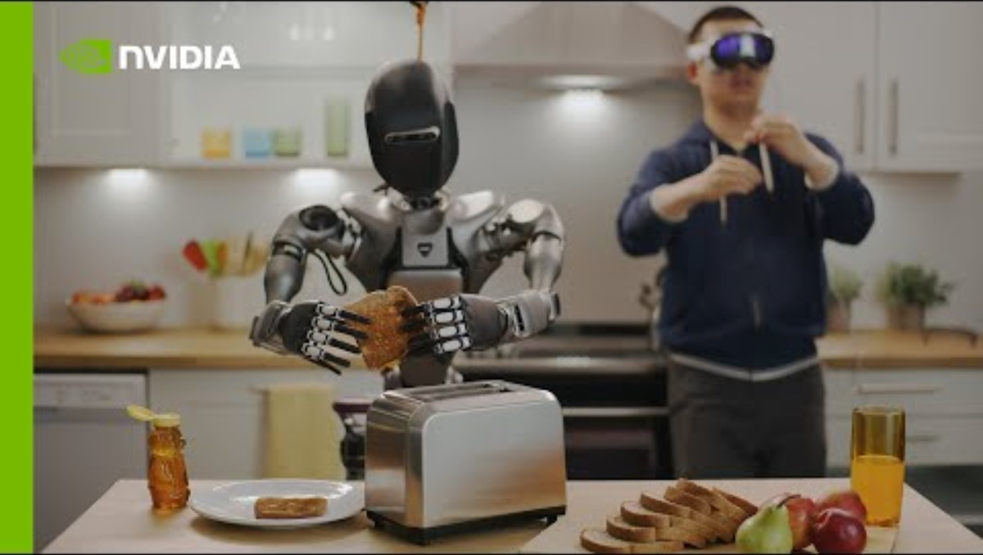
Similar Apps

Slide 9
Initial Challenges
Setting up Development Environment
Learning Curve for visionOS Development
visionOS APIs (RealityKit, ARKit, and VisionKit)
Using Machine Learning models on Hugging Face

Slide 10
Initial Challenges
Converting collected data from Vision Pro to model-compatible inputs for data processing
Building skills in Machine Learning, Computer Vision, AR/VR Development

Slide 11
Thank you!

